Slide 1
Implementation of the Master’s Degree in Nuclear Security at UNWE: Lessons Learned
EURATOM INFODAY
Prof. Dr. Dimitar Dimitrov,
University of National and World Economy - Sofia, Bulgaria
E-mail: dimdim@unwe.bg
12 September 2016, University of National and World Economy,
Sofia, Bulgaria

Slide 2
Prof. Dr. Dimitar Dimitrov
Dean of Faculty 'Economics of Infrastructure'
Head of Department 'National and Regional Security'
Director of Nuclear Security Support Center
www.e-dnrs.org
New Master Programme in Nuclear Security
http://www.unwe.bg/nuclear-security/en

Slide 3
My University www.unwe.bg

Slide 4
UNWE – est. 1920
20 000 students
8 Faculties
500 full time teaching staff
1000 part time teaching staff
Economics, Sociology, Political science, Law, Journalism, Management and administration

Slide 5
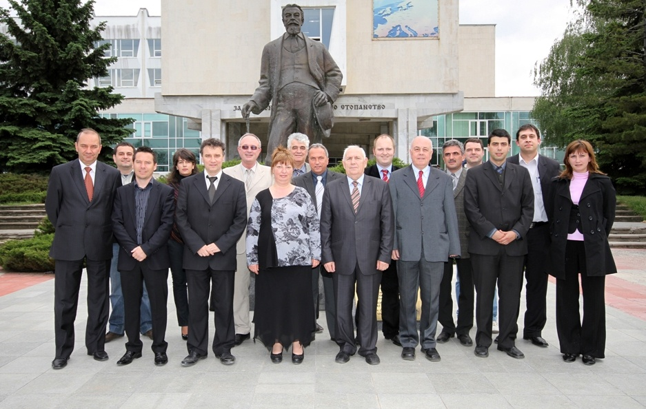
The department www.e-dnrs.org

Slide 6
The department (est.1990) www.e-dnrs.org
10 full time teaching staff
30 part time
60 Bachelor students per year
100 Master students per year
18 PhD students currently
Specialty ‘Security and Defense Economics’

Slide 7
Programs and Research
Bachelor and Master Programmes on Security and Defence Economics, Corporate Security
Research on Crisis Management, Critical Infrastructure Protection, Natural Hazards, Economic Aspects of Terrorism, etc.

Slide 8
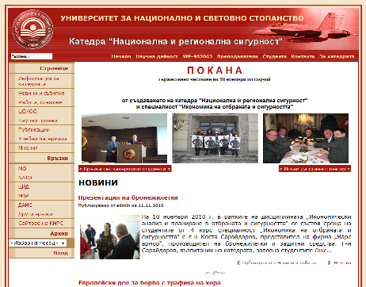
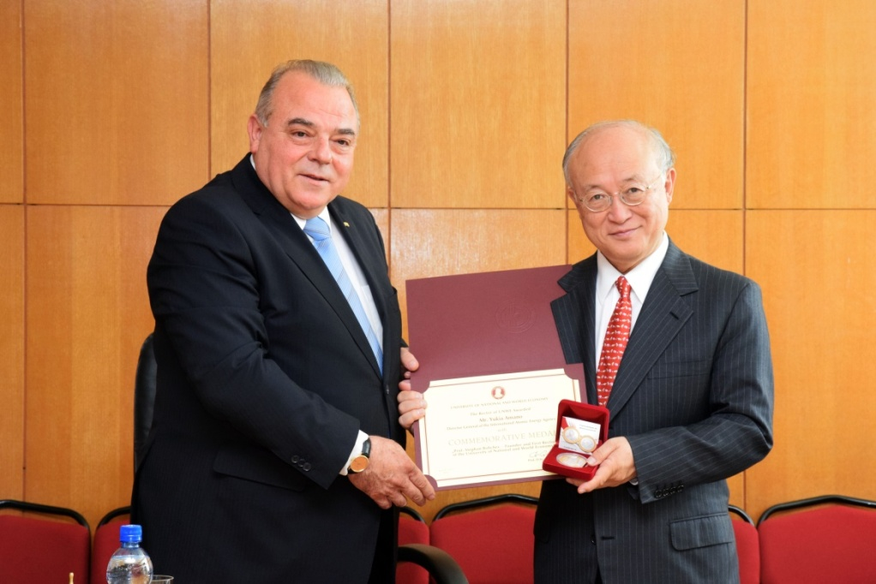
The department www.e-dnrs.org

Slide 9
Agreement UNWE – IAEA July 2014

Slide 10
Our timeline in Nuclear Security
April 2014 - INSEN membership
July 2014 – Mr. Amano visit in Bulgaria
August 2014 – Decision to go forward with Master Programme in Nuclear Security
August 2015 – Collecting application of Prospective students
November 2015-START of the PROGRAMME

Slide 11
First group - The students
10 students enrolled Lebanon, Jordan, Nigeria, Burkina Faso, Zambia, Bulgaria
Nominated by their governments
With suitable background and experience
Supported by IAEA
With perspectives for professional career in Nuclear security

Slide 12
Master programme opening

Slide 13
Master programme on Nuclear Security
- International, in English
In cooperation
Fully based on IAEA NSS 12
22 disciplines
40 lecturers
Among the few in the world

Slide 14
Experience of other universities
Delft
Brandenburg
INSEN members
USA

Slide 15
Between August 2014 and August2016
Big challenge
Curriculum development and approval – Faculty and Academic Councils, National Regulations
Training of Trainers – assistance by IAEA, UGA
Providing lecturers and learning materials

Slide 16
Nuclear Security Master Program’s website
http://www.unwe.bg/nuclear-security/en

Slide 18
We are in Facebook
https://www.facebook.com/nusecUNWE/?ref=aymt_homepage_panel
Google classroom (online materials and communication)

Slide 19
Our teaching consortium - 1
University of National and World Economy- Sofia
Sofia University
Technical University – Sofia
Bulgarian Academy of Sciences

Slide 20
Our teaching consortium - 2
Bulgarian Nuclear Regulator
Bulgarian Nuclear Power Plant ‘Kozloduy’
Nuclear business and associations
MIIS at Monterey, California
King’s College London
Lecturers provided by IAEA (Greece, Romania) , practitioners, visits

Slide 21
IAEA and INSEN assistance
Lecturers
Training
Teaching materials
Fellowships

Slide 22
UNWE – system integrator
Bulgaria
– cost-efficient place

Slide 24
Other activities
National Nuclear Security Support Center- April 2016
Member of NSSC Network

Slide 25
UNWE – system integrator

Slide 26
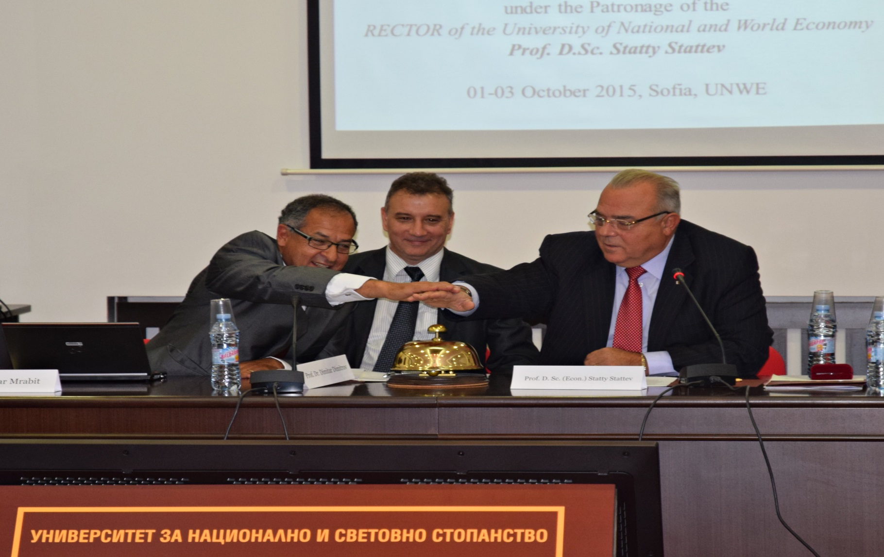
International seminar on Human Resource development – Sofia, October 2015

Slide 27
National Nuclear Security Support Center – complimentary to the Master programme
Broader audience
Involvement of practitioners

Slide 28
Visits to NPP Kozloduy, Airports, Border checkpoints, waste disposal facilities, part of our Master programme in Nuclear Security

Slide 29
Next group – New Admission Cycle of the Master's programme in Nuclear Security 2016-2017
20 foreign applicants
Diploma’s recognition and visas

Slide 30
Problems
Nuclear Security is a Public Good
Nuclear Security is an International Public Good

Slide 31
Implications 1
Fellowships, Stipends
Support from Governmental and International Organizations;
Training of Trainers (young colleagues)
Teaching Materials, Learning Techniques, Case Studies, On-line materials,
Internships

Slide 32
Implications 2
Coordination of UNWE efforts with NSSC, PNS and EU programmes
Need for more practical training
A lot of administrative work
Smart approach to funding constraints and support priorities’ programmes
Establishing educational projects

Slide 33
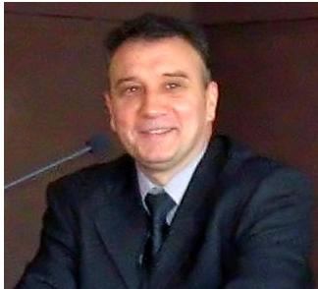
Thank you for your attention!
dimdim@unwe.bg
ddimitrov@e-dnrs.org

